Slide 1


Project Name: ‘AIO Med Guide’
Team Members: 1. Snehesh Dutta
2. Sinjon Nath
3. Shouvik Saha
4. Siddhartha Vyas
5. Debajyoti Dutta

Slide 2
Problem Statement
It is very hard to have a good medical guide at the time when it's needed very much. Taking proper decision at the critical time is also very essential for or a patient. Not only that, wasting time for finding a good nearest hospital in an unknown place can push a patient towards the death. That's why building a proper solution, for all in one medical help and guide , that can help a patient to maintain his medical-care routine, can help a person to find proper medicine for a particular disease, can keep every person up-to-date with all health related information, have proper guideline for the first aid treatment and can help to guide the nearest hospital quickly.
Not only that the solution should also provide the latest information about new disease or new health related issues, like ‘COVID-19’ updates, and prevention techniques. Having some more helpful features will always help people to stay safe.

Slide 3
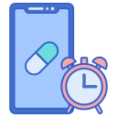



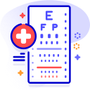



Proposed Solution
Our solution will help a patient to maintain his Medicare routine by setting alarm or sending notification.
Our solution will provide personalize medical and health related news.
Reminder for
Medicare Routine
Personalized
Medical News
Our solution can guide a person to find the nearest hospital from his current location.
Our solution can give proper guides for first aid treatments.
Guide to
Nearest Hospital
Proper Guides for
First Aid Treatments
Our solution will provide our client personalized health tips.
This solution also come sweet latest covid-19 safety points and prevention techniques.
Persinalized
Health tips
COVID19
Safty points
Search Your
Medicine
Virtual Risk
Analyzer
Our solution includes a virtual analyser for covid-19.
Our solution will help patient to search medicine for their disease

Slide 4
Unique Selling Point
PERSONALIZED FEEDS
Our solution includes personalized news and feed for the patient related to to his disease for his needs.
USER INTERFACE
We are providing a very neat and clean and easy to access user interface so that the app experience of our users will be great.
USP no
01
USP no
04
USP no
02
CROSS PLATFORM
Our solution will be available for devices across cross platform.
VIRTUAL ANALYZER
Our app have a built-in feature to analyse virtually the risks of getting affected by covid-19.
USP no
05
DOCTOR’S CHOICE
We have taken suggestion and guides from some good experience doctors.
ATMANIRBHAR INDIA
The sole purpose of making this medi-care solution is to make our user self dependent.
USP no
03
USP no
06

Slide 5



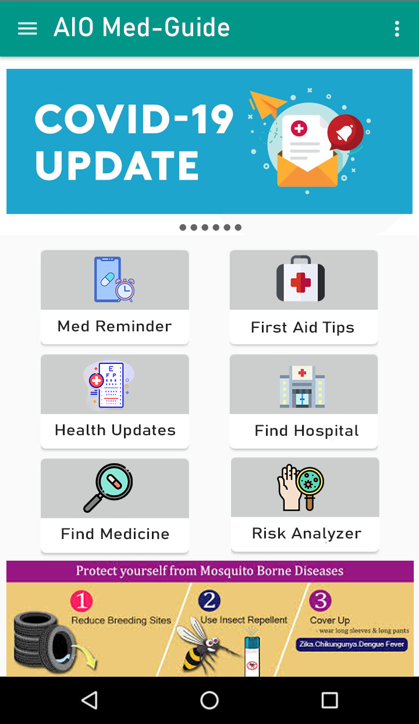





Proposed TechStack
Android Studio Screenshot

Slide 6
How our idea makes India Atmanirbhar
The main motto of our solution is to make our users atmanirbhar. That means with the help of our solution medical patients of India can be self dependent.
With the help of our Medicare reminder feature any patient cant take their medicine in time without the help of any family member or nurse. People will not ask anyone for the guiding help as from now with the help of a solution they can easily find the nearest hospital or the Medicare center. Also people will remain up to date with the latest medical and health related news and tips. So that they can step ahead in the modern world. People can check the proper medicine for his disease it will help him to stay away from the fraud doctors. And user will also receive the latest updates of any recent disease like COVID-19 or any newly discovered vaccine. The personalized feed will also help them to become more knowledgeable and confident about his disease for his health. That's why we can say our solution has the potential to make ‘India Atmanirbhar’.

Slide 7
THANK YOU!

